Slide 1




Hospital Data Report
(2019-2024)

Slide 2
Table of Contents
Executive Summary
Patient Demographics
Age & Seasonal Patterns
Medical Conditions
Test Results
Insurance & Revenue
Admissions & Discharge Trends
Recommendations
Conclusion

Slide 3
Executive Summary
Total Patients: 55,500
Total Revenue: $1.42 Billion
Average Patient Age: 51.54 years
Average Length of Stay: 15.51 days

Slide 4
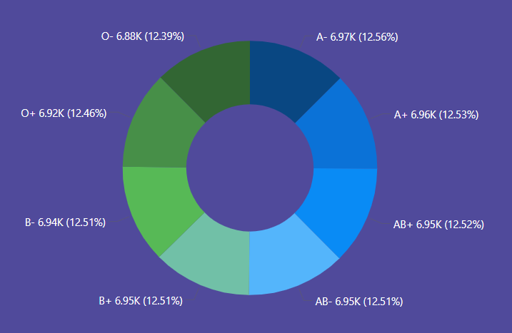
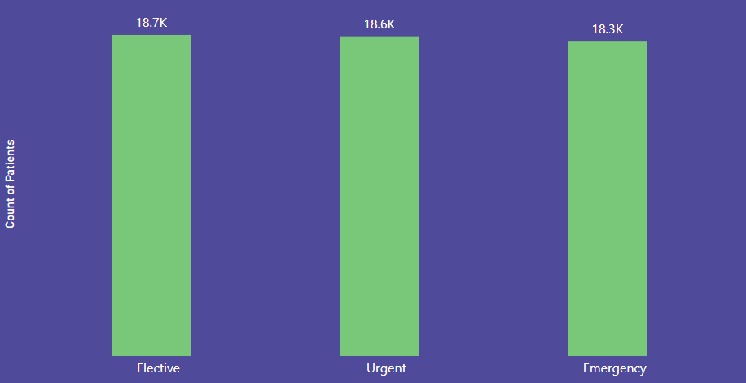
Patient Demographics
All major blood types are represented near equally, each accounting for about 12–12.5% of patient volume, demonstrating demographic diversity and suggesting that services are inclusive of the broader population’s needs.
Patient counts are evenly distributed among Elective (18.7K), Urgent (18.6K), and Emergency (18.3K) admissions, indicating a balanced mix of scheduled procedures, urgent cases, and emergencies within hospital operations.

Slide 5
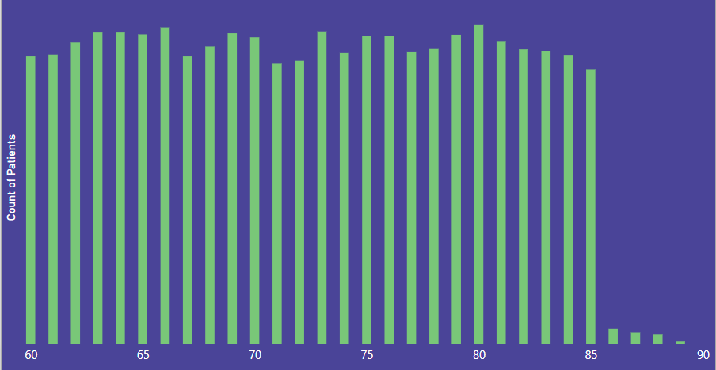
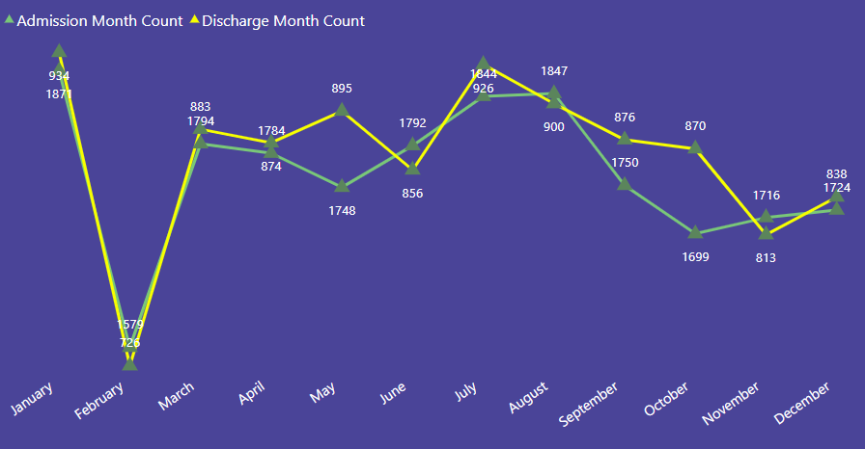
Age & Seasonal Patterns
Admissions peak in January, August, and September, reaching their highest numbers during these months, while a sharp decrease is seen in March.​
Discharges closely follow the admissions trend but consistently remain lower than admission counts each month.​
The lowest admissions and discharges both occur in March, followed by a rapid recovery from April onward.​
Discharge numbers are slightly lower than admissions, indicating ongoing inpatient care or delayed discharges for certain cases

Slide 6
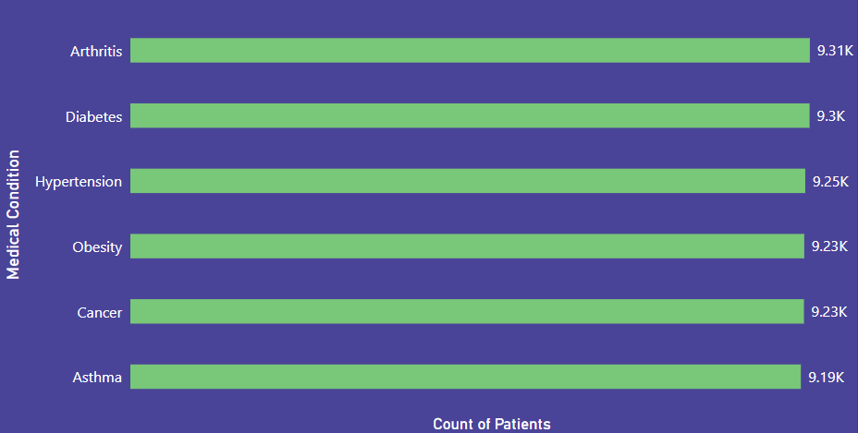
Medical Conditions
The most common medical conditions among patients are arthritis (9.31K), diabetes (9.3K), hypertension (9.25K), obesity (9.23K), cancer (9.23K), and asthma (9.19K), each affecting over 9,000 patients. Arthritis has the highest patient count, closely followed by diabetes and hypertension. This highlights chronic diseases as a significant challenge for the hospital population.

Slide 7
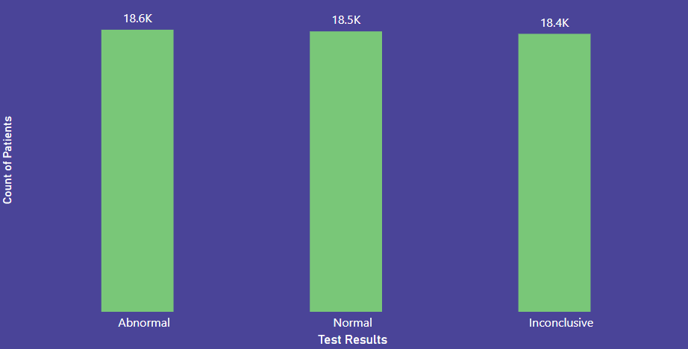
Test Results
Patient test results are nearly evenly distributed: 18.6K are abnormal, 18.5K are normal, and 18.4K are inconclusive. The similar counts across categories suggest a high volume of diagnostic testing, with significant follow-up needed for abnormal and inconclusive outcomes.

Slide 8
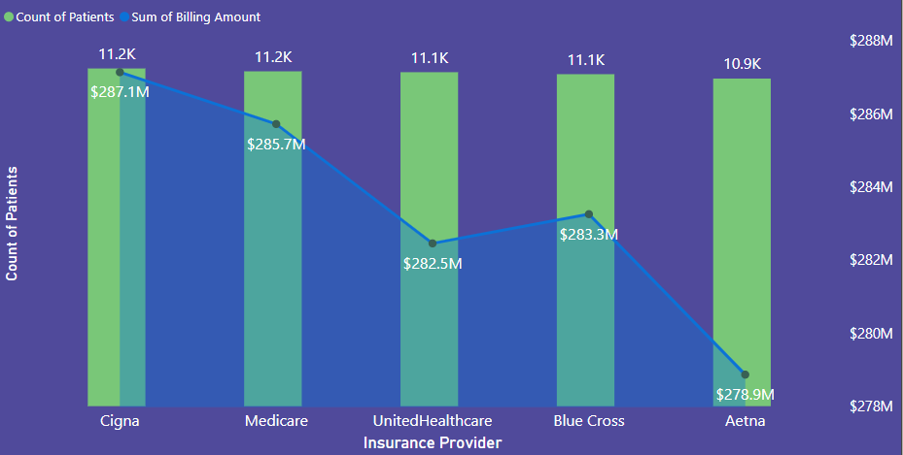
Insurance & Revenue
The hospital has a relatively consistent patient count across major insurance providers, each with around 11,000 patients. Billing amounts vary slightly, with Cigna topping at $287.1M, followed closely by Medicare at $285.7M, Blue Cross at $283.3M, UnitedHealthcare at $282.5M, and Aetna at $278.9M. This indicates stable patient engagement and significant billing across these key insurers.

Slide 9
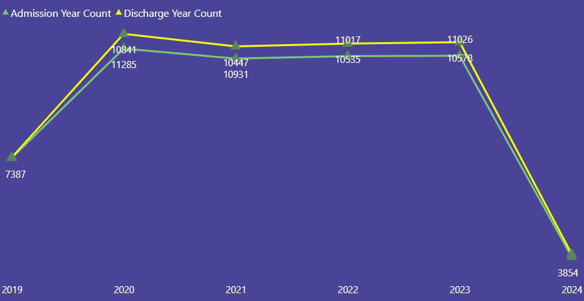
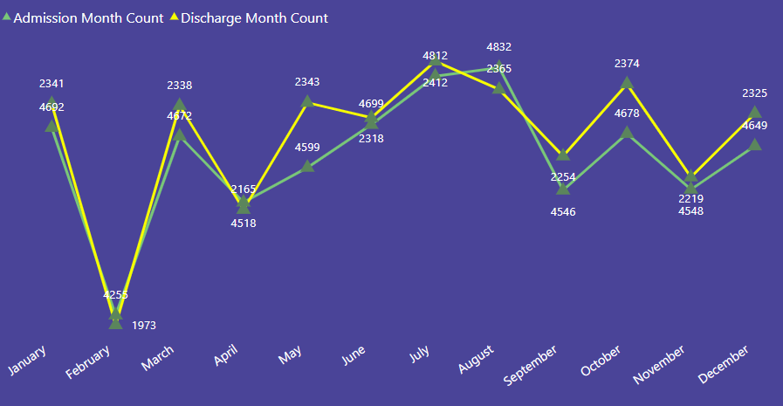
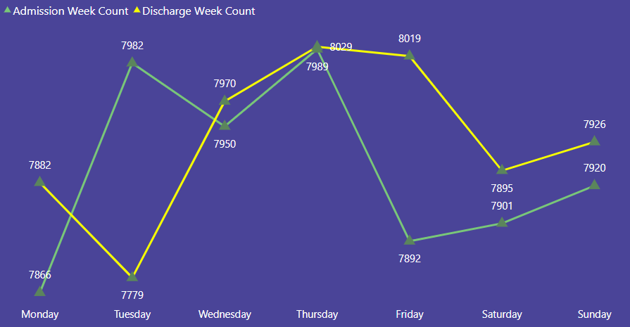
Admissions & Discharge Trends
Admissions and discharges are highest from 2020 to 2023 and drop sharply in 2024. Monthly, admissions and discharges peak in July and October. Weekly, the busiest days are Wednesday and Thursday, with lower activity on Monday, Saturday, and Sunday.

Slide 10
Recommendations
Optimize patient stay and discharge
Enhance chronic disease management
Allocate resources for seasonal peaks
Automate abnormal result follow-up

Slide 11
Conclusion
Strong financial performance and stable volumes
Key opportunities in efficiency and care improvement

Slide 12
THANK YOU
SRI YAMINI

